Slide 1

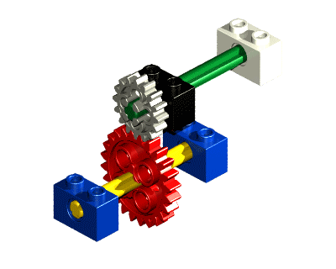
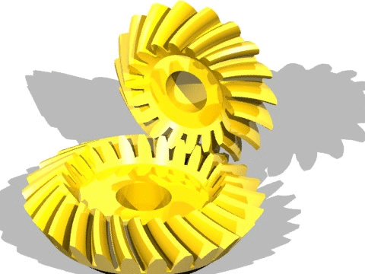
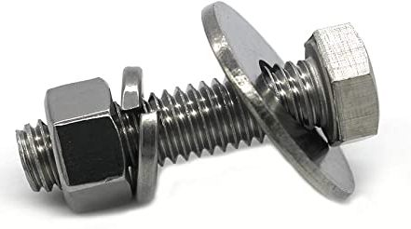

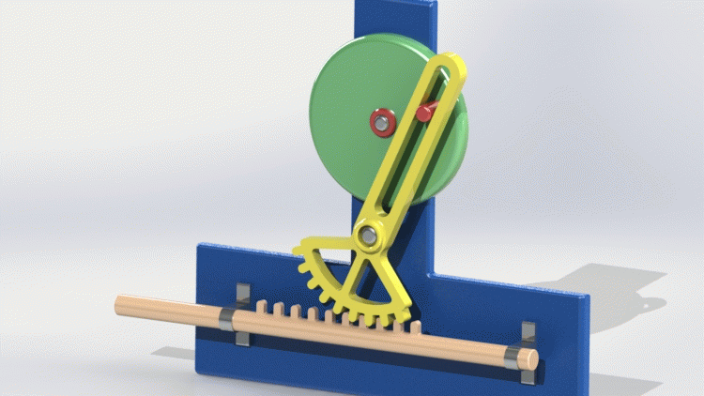
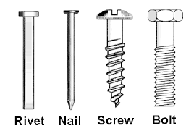
RME Lab – 1
Mechanical Components – 1
FY – DESH – VIT
Vishwakarma Institute of Technology
FY - Department of Engineering, Sciences and Humanities

Slide 2
Prismatic Joint (Linear)
Gripper
(End effecter)
Arm 2
Wrist
Arm 1
Joint 2
Vishwakarma Institute of Technology
FY - Department of Engineering, Sciences and Humanities
Base
Base, Arms, Joints, Wrist, Slider and Gripper –
Mechanical Structure of a Robotic Manipulator
Joint 1

Slide 3
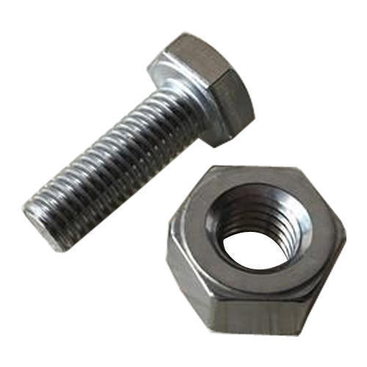
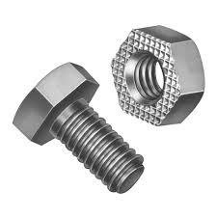
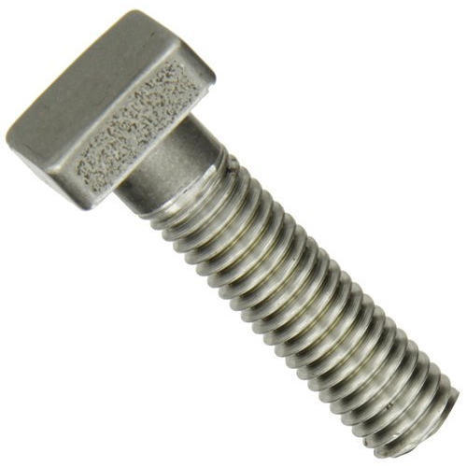
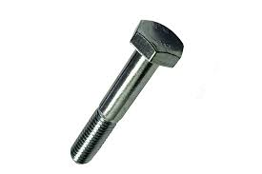
Mechanical Components
Nut and Bolt
Which one of these is the Nut ?
Vishwakarma Institute of Technology
FY - Department of Engineering, Sciences and Humanities
Square headed bolt
Half threaded bolt

Slide 4
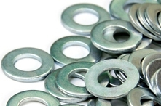
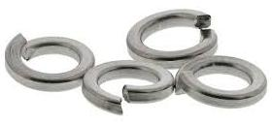
Mechanical Components
Washer
Vishwakarma Institute of Technology
Plane washer
FY - Department of Engineering, Sciences and Humanities
Spring washer

Slide 5
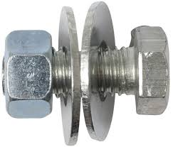
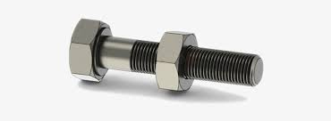
Mechanical Components
Vishwakarma Institute of Technology
FY - Department of Engineering, Sciences and Humanities
Nut and Bolt and washer assembly

Slide 6
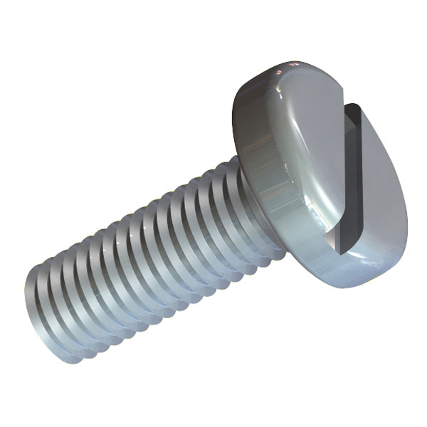
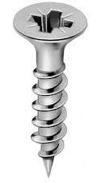
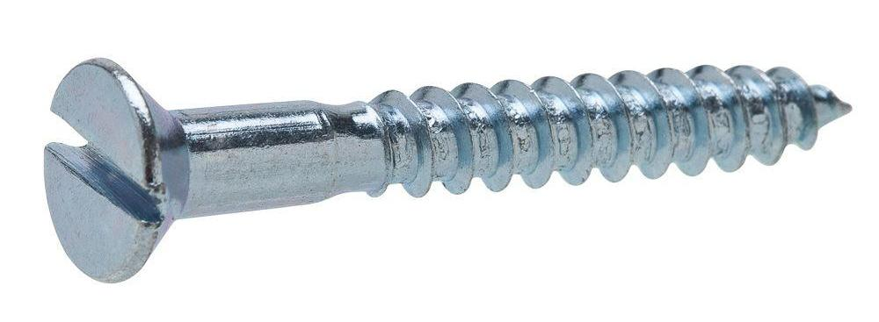
Mechanical Components
Vishwakarma Institute of Technology
FY - Department of Engineering, Sciences and Humanities
Round head bolt with Slot
Screws

Slide 7
Mechanical Components
Vishwakarma Institute of Technology
FY - Department of Engineering, Sciences and Humanities

Slide 8
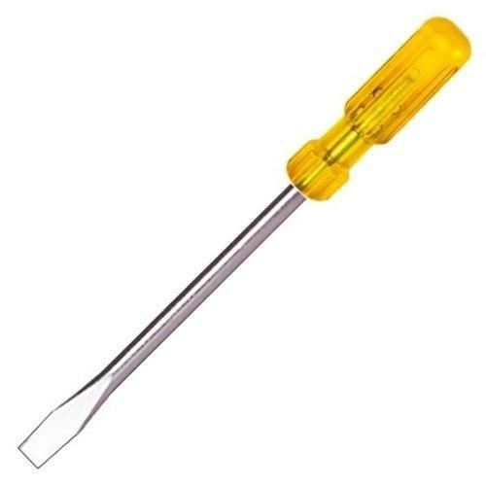
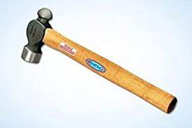
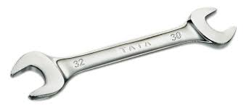
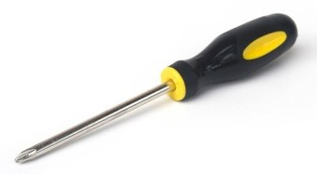
Mechanical Components
Match the pairs …..
A
B
Vishwakarma Institute of Technology
FY - Department of Engineering, Sciences and Humanities
D
C

Slide 9
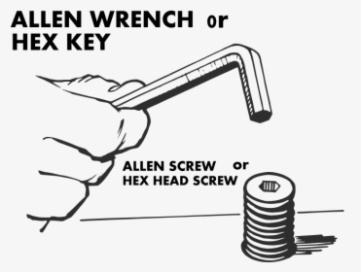
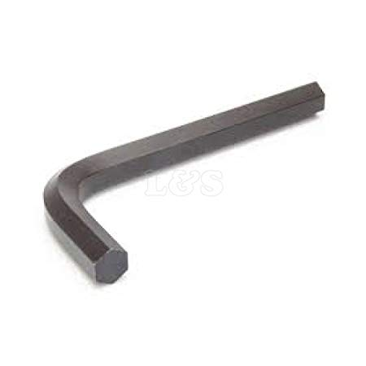
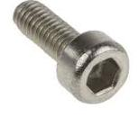
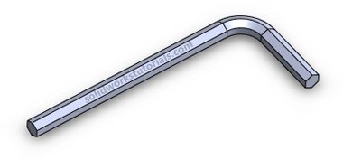
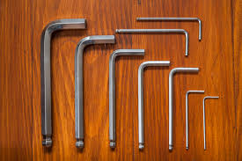
Mechanical Components
Allen Key and Bolt
Vishwakarma Institute of Technology
FY - Department of Engineering, Sciences and Humanities
Allen Key set

Slide 10
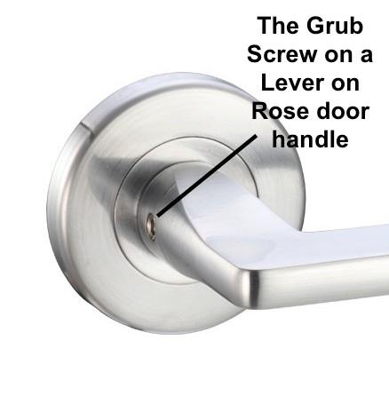
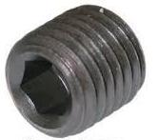
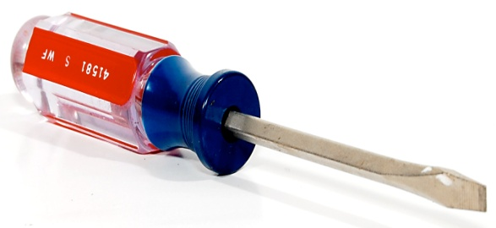
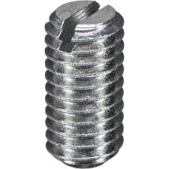
Mechanical Components
Vishwakarma Institute of Technology
FY - Department of Engineering, Sciences and Humanities
Grub Screw application
Grub Screw / Bolt
(Head less)

Slide 12
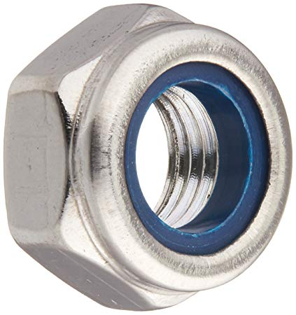
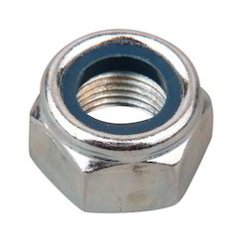
Mechanical Components
Vishwakarma Institute of Technology
FY - Department of Engineering, Sciences and Humanities
Lock nut with a plastic ring inside

Slide 13
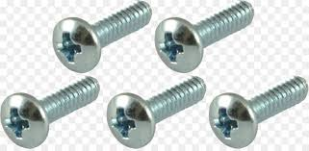
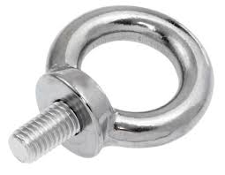
Mechanical Components
Round head bolt with Star
Eye bolt
Vishwakarma Institute of Technology
FY - Department of Engineering, Sciences and Humanities

Slide 14
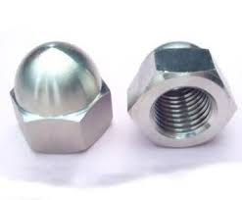
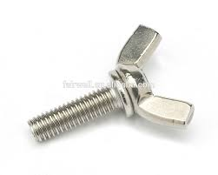
Mechanical Components
Wing Bolt
Dome Nut
Vishwakarma Institute of Technology
FY - Department of Engineering, Sciences and Humanities

Slide 15
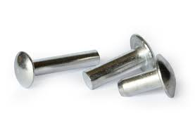
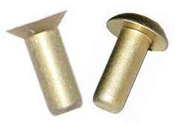
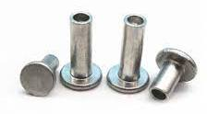
Mechanical Components
Rivets – soft material
Vishwakarma Institute of Technology
FY - Department of Engineering, Sciences and Humanities

Slide 16

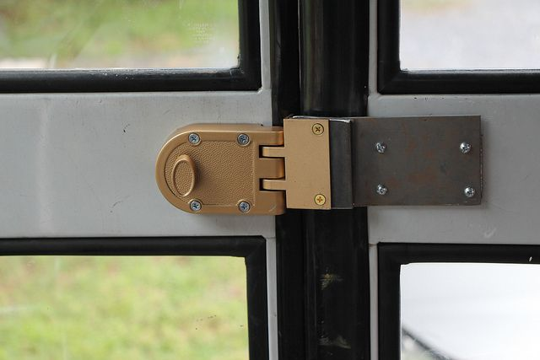
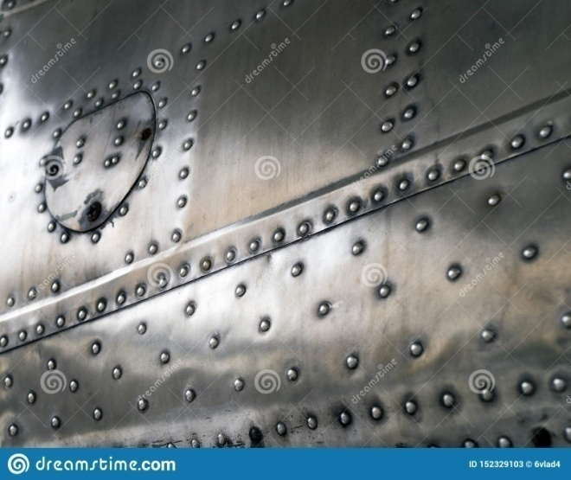
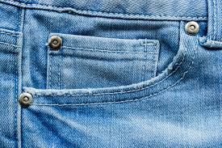
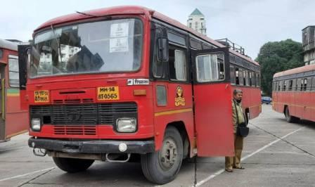
Mechanical Components
Rivets – soft material
Vishwakarma Institute of Technology
FY - Department of Engineering, Sciences and Humanities

Slide 17
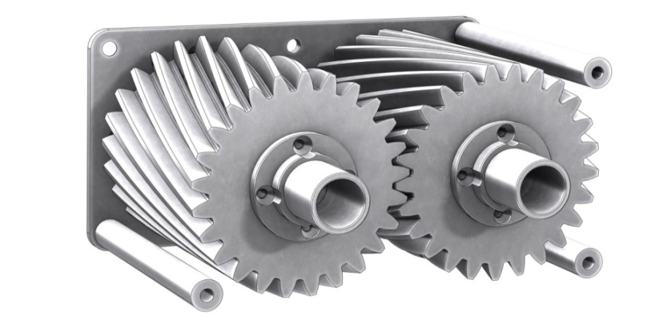
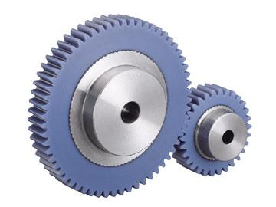
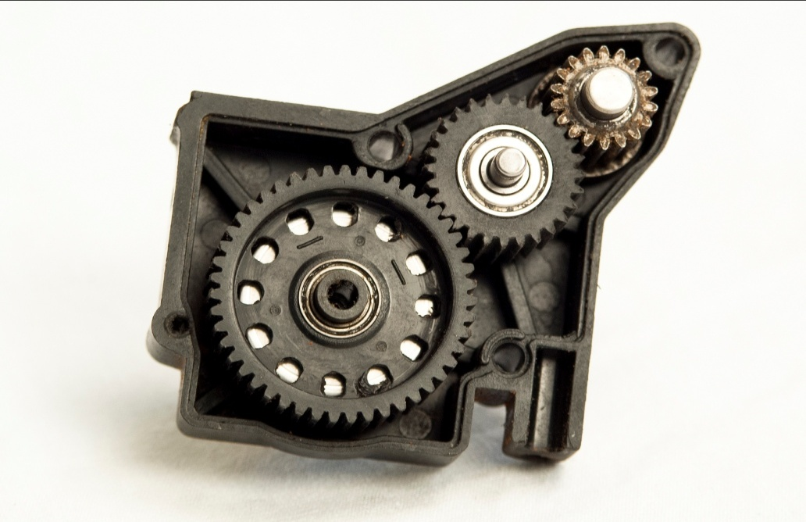
Mechanical Components
Spur Gears
What is the difference ?
Vishwakarma Institute of Technology
FY - Department of Engineering, Sciences and Humanities
If the middle gear runs clockwise, what will be the direction of the other two ?

Slide 18

Mechanical Components
Spur Gears
Vishwakarma Institute of Technology
FY - Department of Engineering, Sciences and Humanities
Will the 3 gears above run at the same speed ?
Which will have the highest speed ?
Why ?

Slide 19
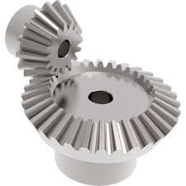
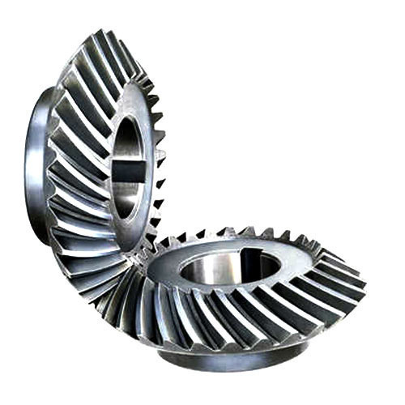
Mechanical Components
Bevel Gears
What is the difference ?
Vishwakarma Institute of Technology
FY - Department of Engineering, Sciences and Humanities
What can you say about the two shafts of the two gears ?
Can your compare them with shafts of spur gears ?

Slide 20
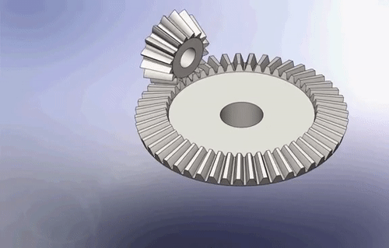
Mechanical Components
Bevel Gears
Vishwakarma Institute of Technology
FY - Department of Engineering, Sciences and Humanities

Slide 21
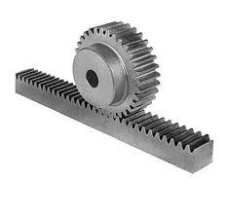
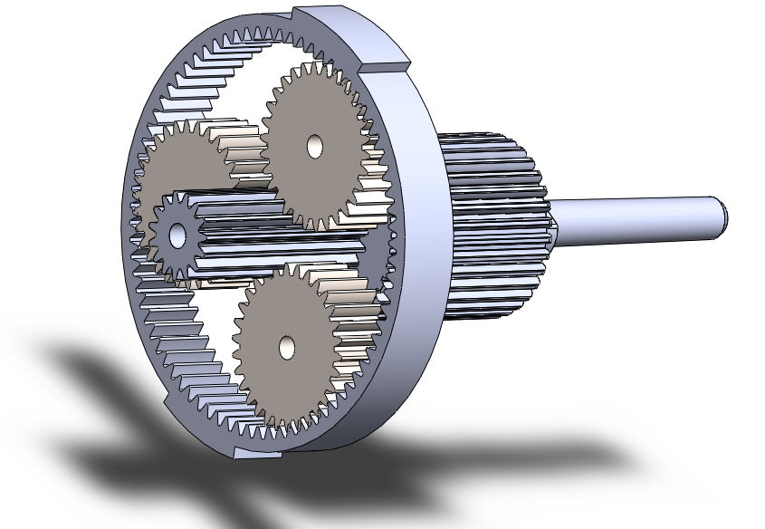
Mechanical Components
Planetary Gears
Vishwakarma Institute of Technology
FY - Department of Engineering, Sciences and Humanities
Rack and Pinion

Slide 22


Mechanical Components
Sun
Gear
Planet Gears
Rack and Pinion
Vishwakarma Institute of Technology
FY - Department of Engineering, Sciences and Humanities
Planetary Gears
Application of R&P

Slide 23


Mechanical Components
Worm and Worm Wheel
Vishwakarma Institute of Technology
FY - Department of Engineering, Sciences and Humanities

Slide 24


Mechanical Components
Worm and Worm Wheel
Vishwakarma Institute of Technology
FY - Department of Engineering, Sciences and Humanities

Slide 25
Thanks !
Mechanical Components – 1
FY – DESH – VIT
Vishwakarma Institute of Technology
FY - Department of Engineering, Sciences and Humanities

